Slide 1

What are the conditions for crime in DC?
Hello, and Welcome to my TED Talk.
CRIME IN DC
WHAT CAUSES CRIME IN DC?
Sophia Mir
DATS 6103
Data Mining

Slide 2

DATA
Some Variables:
Offense Group
All offenses are categorized into either Property or Violent crimes
Offense Type
These are the subcategories of crimes: Theft/other, Theft f/ auto, sex abuse, robbery, motor vehicle theft, homicide, burglary, assault w/ dangerous weapon, arson
Method
Gun, knife, other
Shift
Time identifier: Day, evening, midnight
Day: 8 AM - 4 PM
Evening: 4 PM - 12 AM
Midnight: 12 AM - 8 AM
Report Date
Time and day the crime was reported to the police department
Year
Ward
Location identifier
Obtained from the DC Metropolitan Police Department
From January 2020 through May 2022
Number of observations: n = 55,495
Total number of variables: 29
Disclaimer:
These are the incidents reported to law enforcement that were turned into reports.

Slide 3


PREPROCESSING
Imported data/ Checked for missing data/ data structure
Converted the data type to ‘category’ for all variables
Dropped certain variables (i.e. too repetitive or had 45000 NAs)
Imputed missing data
Figured out characteristics of the different variables using unique()
Extracted a new variable ‘MONTH’ out of ’REPORT_DAT’
Created visualizations to better understand the data and existing relationships
Train/test Split

Slide 4


Slide 5


Slide 6


Slide 7


Slide 8


Slide 9


Slide 10


Slide 11
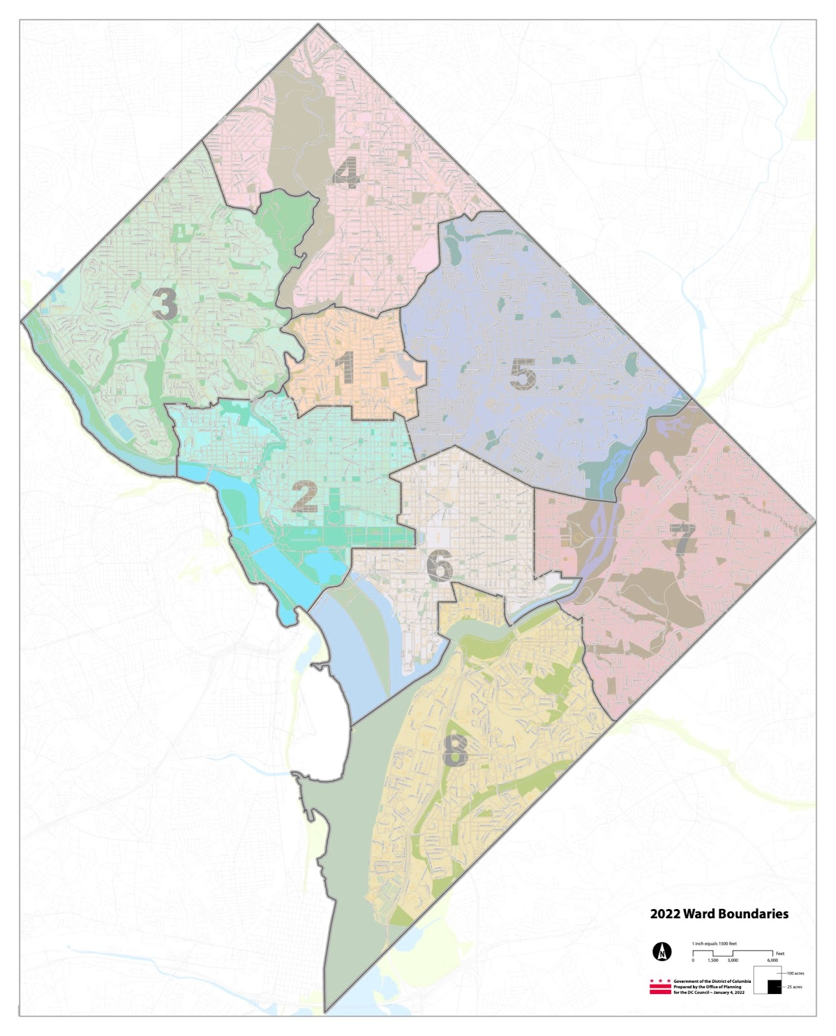

Slide 12


Slide 13


Slide 14


Slide 15


Slide 16


Slide 17


Slide 18
MODELING
Approached it as a classification issue
Target: Property/Violent crime
Features: everything else really
Tried out different models
Random Forest was the winner w/ an accuracy of ~ 94% (overfitting?)
Preferred it to DT since it has built-in bagging

Slide 19


Slide 20


Slide 21

REAL WORLD APPLICATION
Different crimes require different responses and have different protocols
Creating an algorithm that accurately identifies what type of crime is taking place can save valuable time and ↑ success rates

Slide 22

FURTHER DEVELOPMENT
Would include extracting more information from the data
Adding more real-world context to understand upticks in crime or causes thereof

